Slide 1

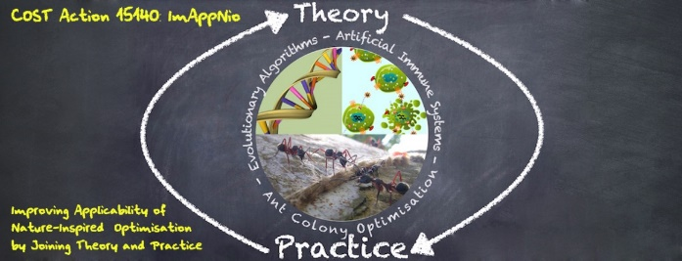

Embeddings
Alberto TONDA, INRA, Université Paris-Saclay

Slide 2
Embeddings
Project input in a (meaningful) vectorial space
Displacements and distances in this space have a meaning
Mostly (but not only) used in Deep NNs
Building the vectorial space is the hard part

Slide 3
Word2Vec
Turn words into vectors of numbers
“Hello” -> [0.2, 3.4, …, 1.1]
Assign random high-dimensional vector to word
Optimize, so that words that appear often nearby in text are close together in the vector space
“Morning”
Optimize
“Morning”
“Good”
“Good”

Slide 4
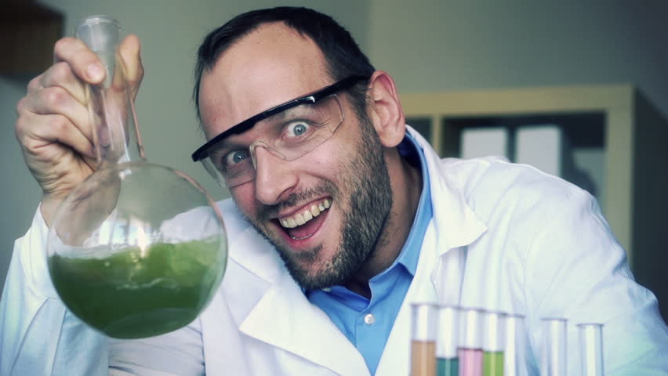
Word2Vec
Apply technique to Wikipedia text
Analyze results with visualization (PCA-like)
???
Profit! SCIENCE!
Notes:
Here they used a technique called t-SNE. So, we try to take a look at how the points generated by this method are distributed, and see if this technique is worth something.

Slide 5
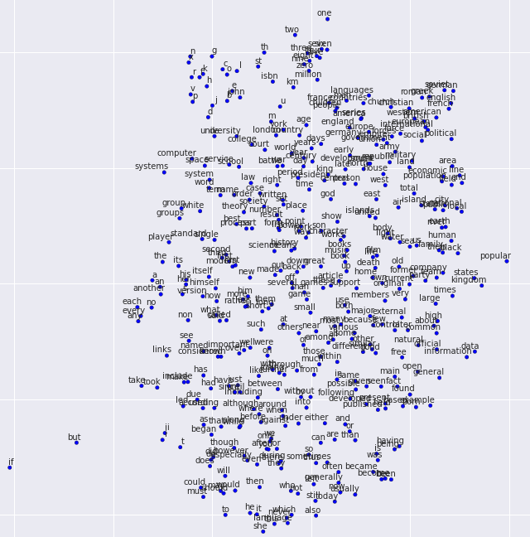

Slide 6
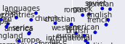
Word2Vec
“French”, “British”, “American”…
Adjectives for nationality!
Nearby, you have “languages”, “countries”
Also, “England”, “Europe”, “International”, …

Slide 8
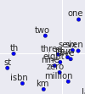
Word2Vec
“one”, “two”, “zero”, “seven”, “million”…
Numbers, quantities
Nearby, you have some units of measurement
Also “th”, and “st”, as in 9-th, 1-st
ISBN (guess usually appears nearby numbers!)

Slide 10
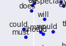
Word2Vec
“does”, “will”, “could”, “must”, “should”…
Auxiliary verbs
Used for questions, for strengthening sentences
Will it work? Could it work? It does seem to work!

Slide 11
Word2Vec
What is happening here?
Algorithm has no semantic info (no meaning)
But words with similar meaning are close
Just by looking at the position of words in text
Words with similar use appear in same positions with respect to other words
Word2Vec captures some aspects of meaning
Can we do something else with Word2Vec?

Slide 12
Word2Vec
Can we do something else with Word2Vec?
“Woman”
WOMAN - MAN
TRANSFORMATION THAT CAN BE COMPUTED
“Man”
Notes:
You subtract one from the other, and you obtain this displacement.

Slide 13
Word2Vec
Can we do something else with Word2Vec?
“Queen”
“Woman”
WOMAN – MAN + KING = QUEEN
“King”
MASCULINE -> FEMININE
“Man”
Notes:
Any predictions on what this transformation might lead to?

Slide 14
Word2Vec
Let’s think about this for a second
No meaning inserted into the algorithm
Words with similar meaning cluster together
Mathematical transformations provide meaningful results
DOG : PUPPY = CAT : ???
PUPPY - DOG
“Puppy”
“Kitten”
“Dog”
“Cat”

Slide 15

Word2Vec

Slide 16

Word2Vec
Algorithms can now infer “some” meaning
Without having to teach “meaning of meaning”
Doc2Vec, now classify similar documents!
th4nk y0u hum4n, n0w I und3rst4nd b34uty, p03try, 4nd th3 hum4n h34rt. 1T’S L44444M3.

Slide 17
Word2Vec
Practical uses
Twitter “sentiment analysis” (might get sarcasm)
Recommend similar books/music (lyrics)
Classify books into categories
Improve automatic text generation
Lots of developments, complex embeddings
ElMO, BERT, OpenAI’s GPT-2
Looks bad, but it’s INCREDIBLE (task really hard) https://talktotransformer.com/
Notes:
ElMO, BERT and GPT-2 are able to encode the same word in different vectors, by taking into account the context (e.g. Some neighboring words).

Slide 18
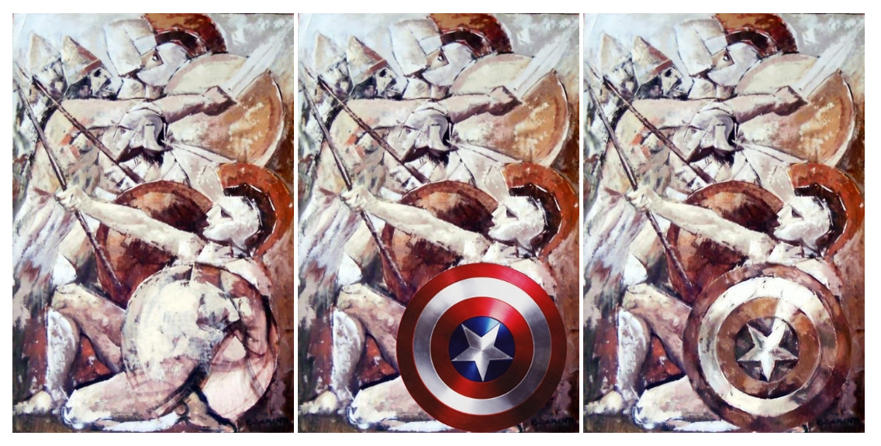
Deep Painterly Harmonization

Slide 19
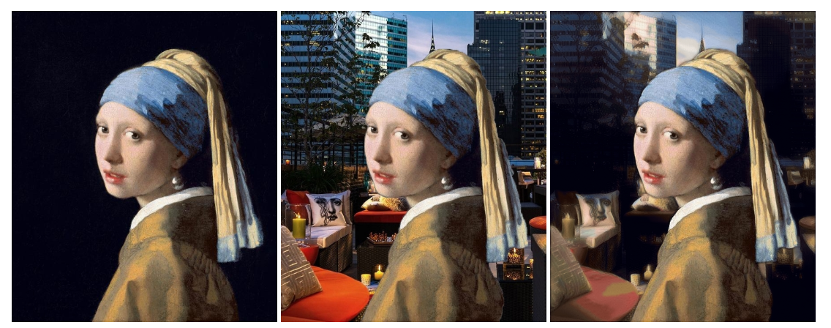
Deep Painterly Harmonization

Slide 20
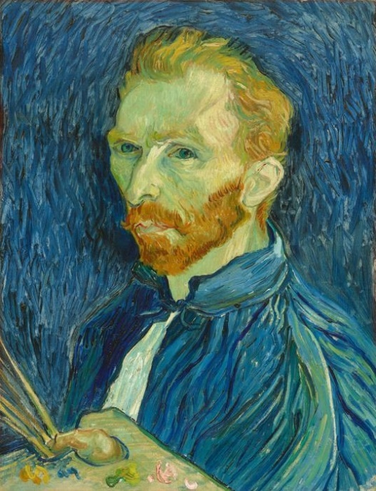


Deep Painterly Harmonization
Also known as «style transfer», more recently
Train DNN (CNN) to classify painting stylization
Expressionism
Pointillism
Realism

Slide 21

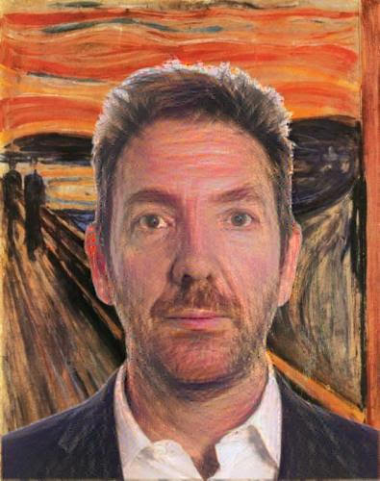
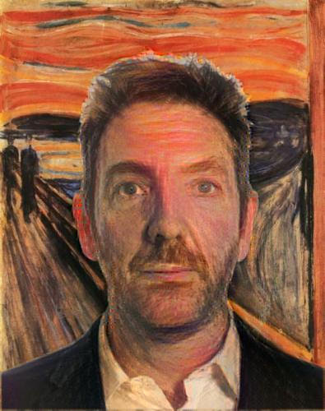

Deep Painterly Harmonization
Use last two layers as embedding
Find position of photo in embedding
Move photo towards a painting, little by little

Slide 22
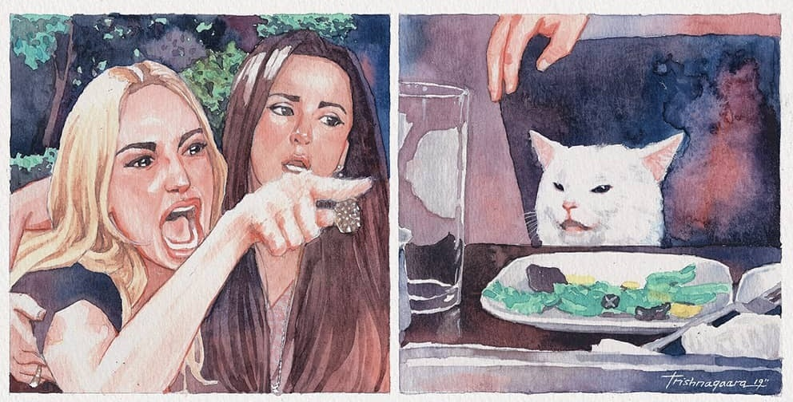
Future Research?
Exploring embeddings?
EAs are usually good at exploration
Fitness function?
I know, I am not a specialist
These ideas are too vague!

